Slide 1
601.226 Data Structures Pre-Requisites Review
Tim Kutcher – Head TA
Fall 2018

Slide 2
Agenda
General Logistics
Environment Setup
General Development
Java Refresher

Slide 3
General Logistics

Slide 4
Contact
Tim Kutcher – Head TA
tkutche1@jhu.edu
Office Hours: Malone (UGrad Lab)
Piazza
https://piazza.com/jhu/fall2018/600226/home

Slide 5
Class Resources
Piazza
https://piazza.com/class/jl345xehd4w3w9
Discussion, announcements, etc.
GitHub
https://github.com/schatzlab/datastructures2018
Primary hub for resources
Gradescope
Entry code: MDJYER
For submitting assignments
Auto-grade functionality
Feedback and regrade requests

Slide 6
Environment Setup

Slide 7
Java Version
We will be compiling and running with Java 8
To check your Java version, run “$ java –version” in terminal
Primary environment and machine up to you, but we provide a VM you might want to use
We will compile with “$ javac –Xlint:all”
JUnit
To be used for unit testing later on in the course and you will need to have this at some point
Many instructions online, our VM comes with it
Checkstyle
Need checkstyle tool (comes with VM)
Configuration file on repository

Slide 8
Machine
See class repository for more detailed set-up information
Unix environment
MacOS or Linux already has Unix terminal
Can always use provided VM
Windows
Ubuntu for Windows
Git Bash
Virtual Machine
VirtualBox
See repository for installation instructions
Transfer files via Drag & Drop, Dropbox, or Git

Slide 9
Development

Slide 10
Developing
Editors
Vim/Emacs (if you’re old school)
Atom, Sublime, VSCode, Notepad++ (Windows), jGRASP(?)
Version Control (Git)
No public repositories
Difference between Git the tool and sites that host the tool
See Tim’s notes on the repository for tips/suggestions
One big (private) repository for the whole class
Markdown for notes
Folder for each assignment
Branch for each assignment (if you are comfortable with branching/merging)

Slide 11
Debugging
Generally start from interface
Write skeleton code that compiles
Build a little at a time, then test
Use main()method of data structures while developing
Write comprehensive unit tests
Commit often, helpful messages
See tips on repository

Slide 12
Java

Slide 13
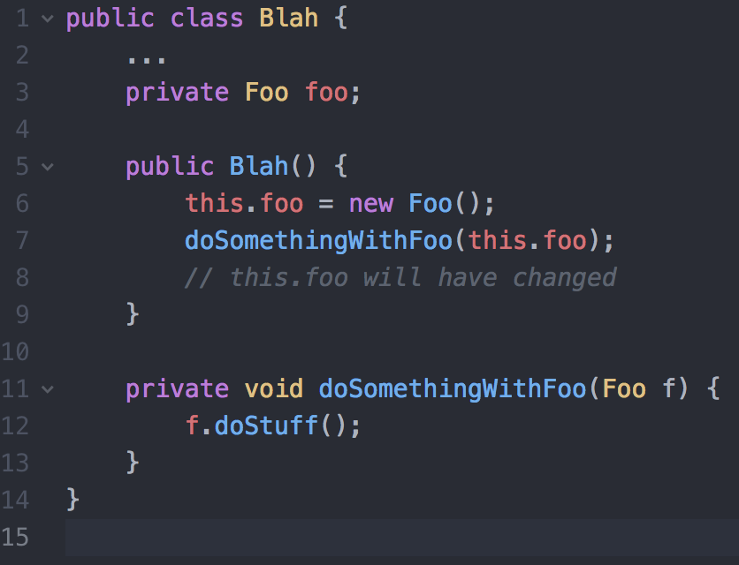
Java & C/C++
Pointers
Not explicit (more on next slide)
Garbage collector
Don’t worry about memory leaks
Parameter passing
All non-primitive types passed by reference
Objects (String, Integer, etc.), your own classes, arrays
If you don’t want changes, you’d need a copy
Primitive types passed by value (int, float, etc.)
If you want changes reflected, return it or wrap in a class
Java is Object-Oriented with same semantics as C++

Slide 14
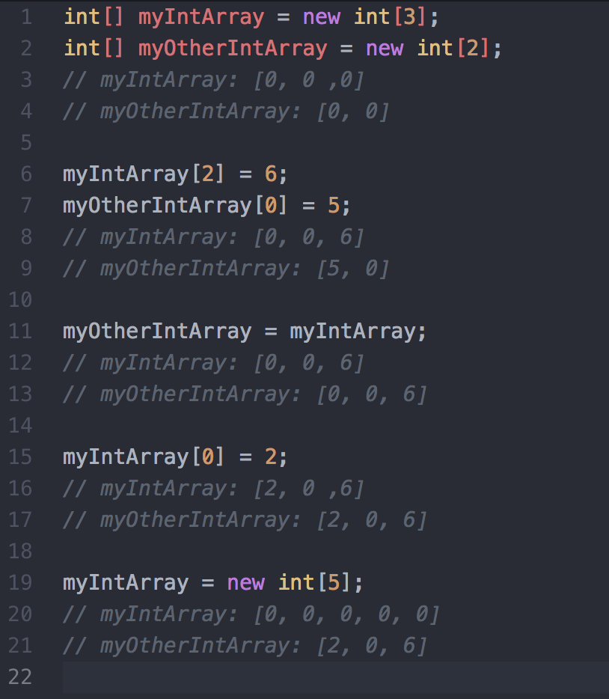
Java & C/C++
Auto-Initialization for default values unlike C
Even in methods
Objects are all null by default
Pointers
Not explicit in Java
Simply an object reference
Think of new keyword like making a new pointer

Slide 15
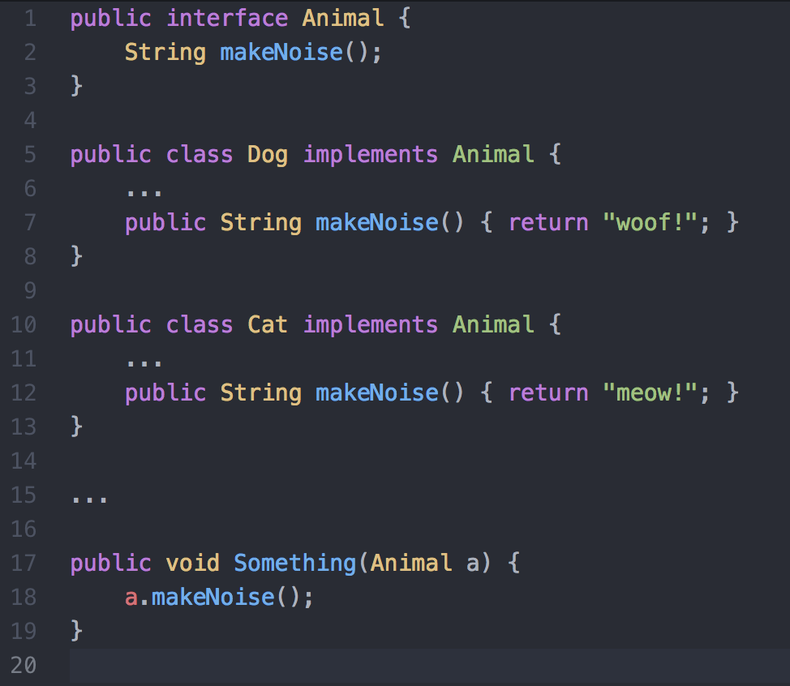
Interfaces
Is a contract for a set of methods that some class will have
Allows for compile-time type checking
In following example, can pass in either a Dog or a Cat to the Something() method
Useful for implementing data structures
For example, many behind-the-scenes ways to make a linked list
When using a linked list, you don’t care how it works behind the scenes but don’t want to write the same method twice for each implementation you use

Slide 16
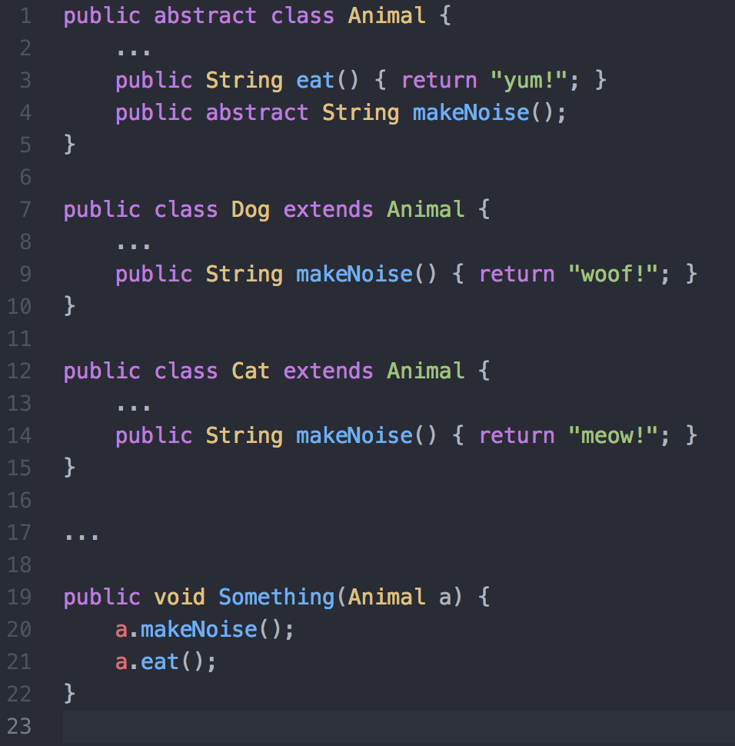
Abstract Base Class
Similar to an interface, but some common methods
Again allows for static compile-time type-checking
Cannot be instantiated, rather is extended from
Abstract keyword indicates subclasses need to override it
Non-abstract methods can still be overridden

Slide 17
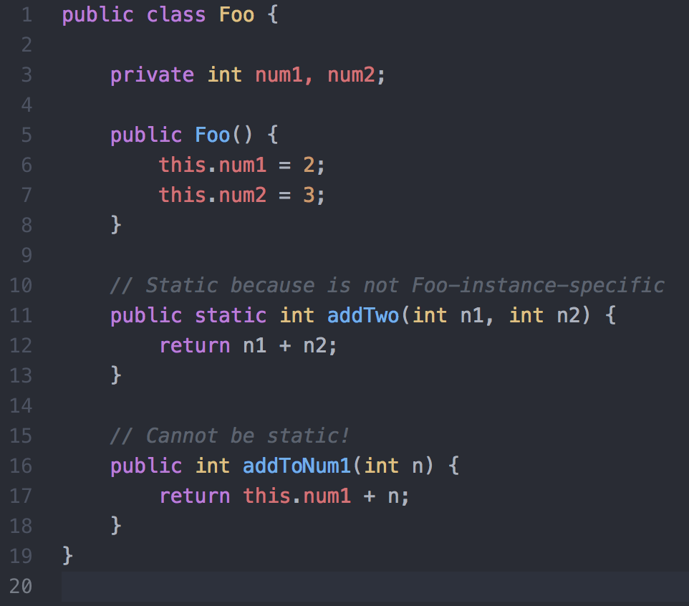
Static
You will probably encounter the “cannot reference static variable from non-static context” at some point
Static essentially means it is not specific to an instance of the object
In the following example, addTwo() can be static
Only comes in to play in this class for inner/nested classes (i.e. we can worry about it later)

Slide 18
Questions

